Slide 1

Welcome to the P2P mentor assisted learning Model

Slide 2

Computer fundamentals

Slide 3


Objective
How does the computer work?
Basic components of a computer?
How does the Internet work?
Client server architecture
Workflow diagram
What is binary?
What is code?
Computer languages - Low & High level
What is the shell/terminal/command-prompt?
Basic computer interview questions

Slide 4

Keywords
https://drive.google.com/file/d/1BOoR6M4b0cqdze0MQGGH482sLFtmOl0F/view?usp=sharing

Slide 5

Introduction
The computer system consists of both hardware components and software components.
The software components provide a set of instructions which directs the various operations performed by the computer hardware components.

Slide 6
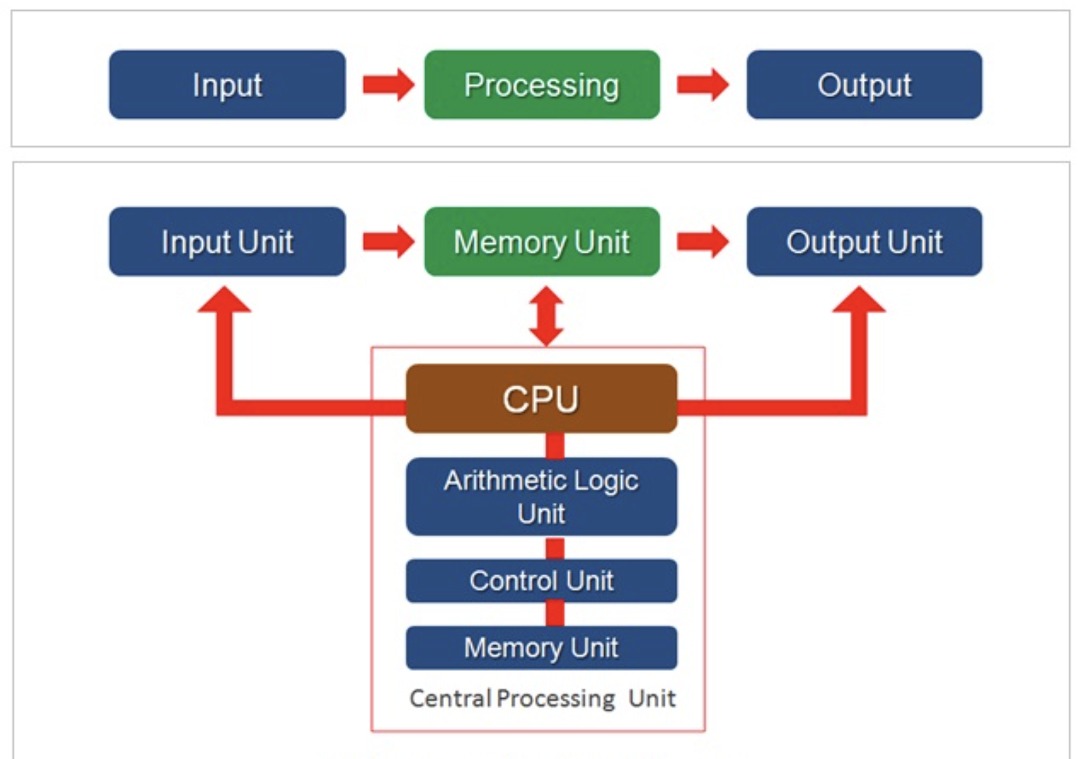

Slide 7
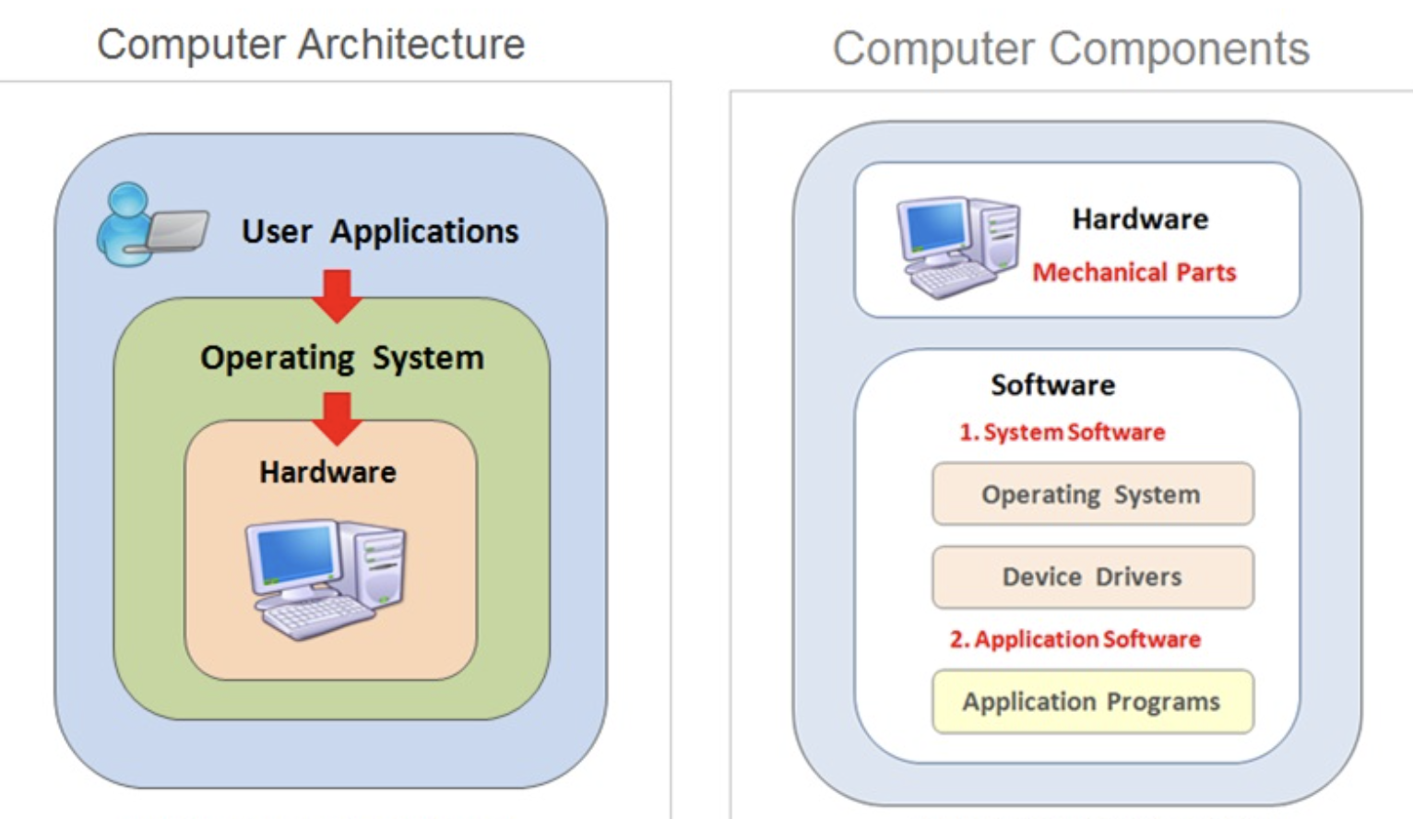
What is a Computer System ?
A computer system is an electronic machine.
A computer is designed to perform various user-specified operations such as printing, calculations, playing music and video and many such applications.

Slide 8
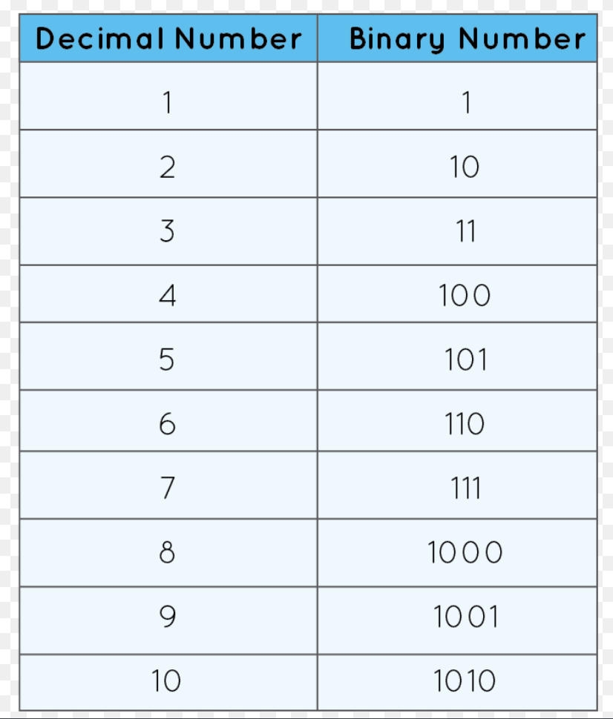
A computer is a digital electronic device because computer system can understand and execute only program instructions in binary
A binary code is represented using a binary number system in which each number is represented using only two numbers that are either numeric zero ( 0 ) or one ( 1 ).

Slide 9
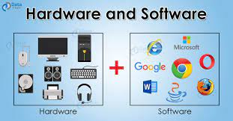
What is Computer Hardware And Software ?
The hardware components are electronic and mechanical components.
The software components are the computer programs necessary to operate the computer hardware components and also to perform user specified other jobs on the system.

Slide 10
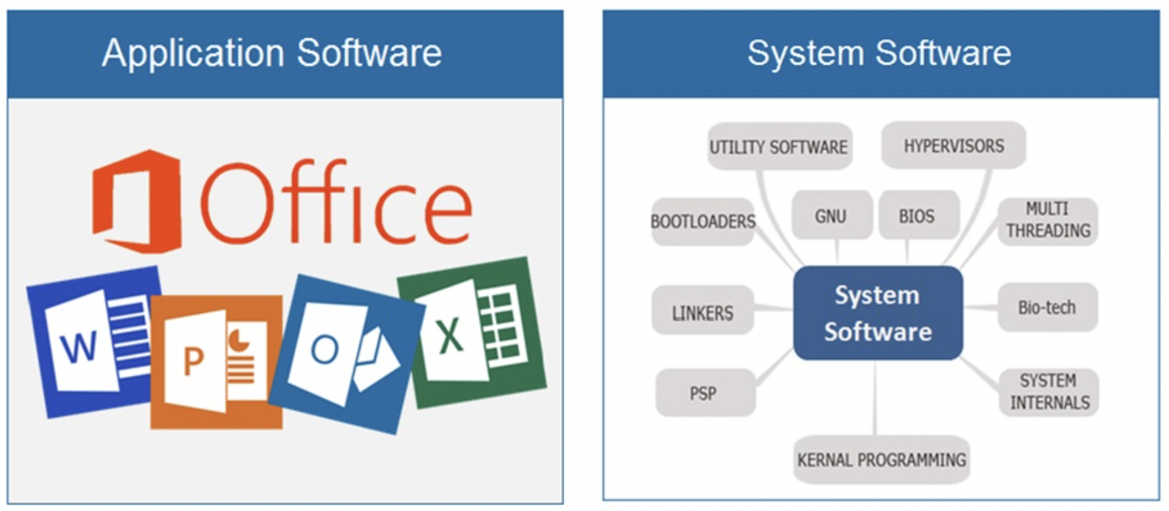
The computer software can be grouped into two categories that is system software and application software

Slide 11
The system software components are used by the computer itself to operate and control the various hardware components and other hardware devices connected to the system .
The system software is a computer program specially created to allow the user to perform various operations such as creating documents , image editing , music players and other such utility programs.

Slide 12
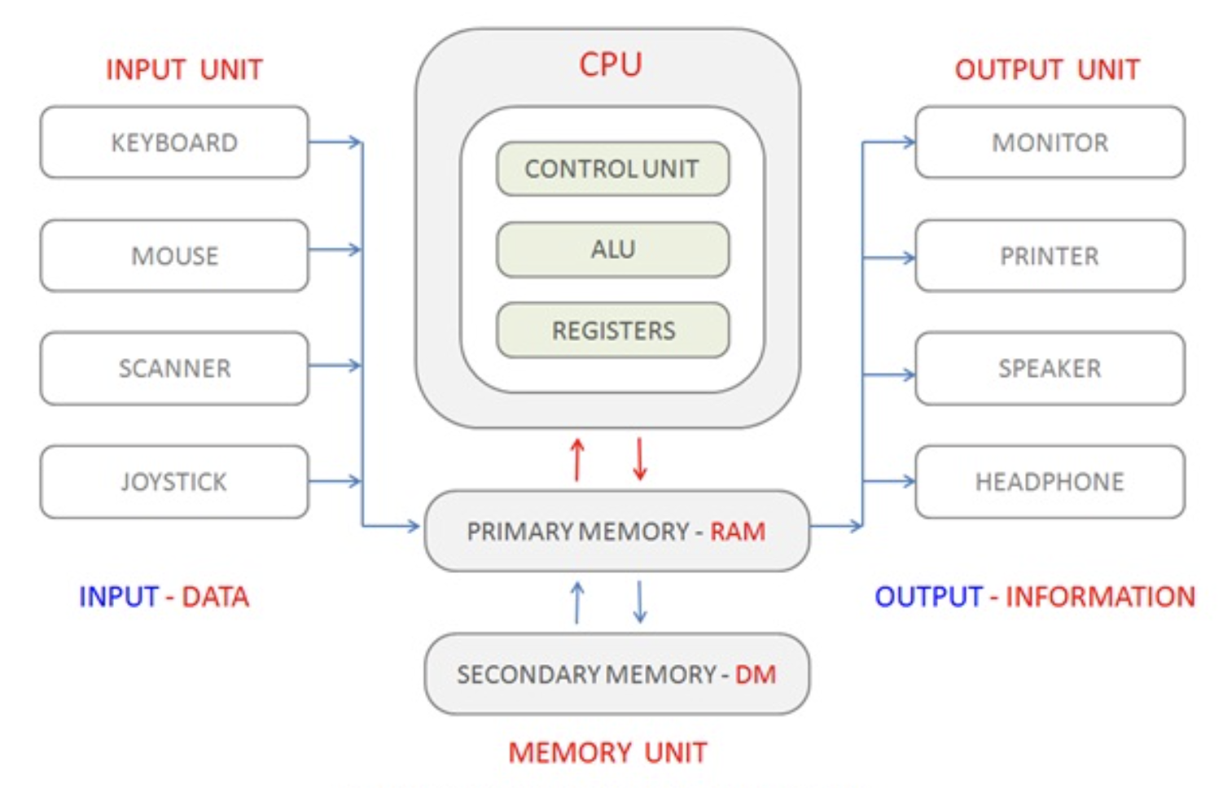
What is Computer System Architecture ?
The system architecture is a blueprint for building a computer system in terms of components, configuration and the technology.

Slide 13
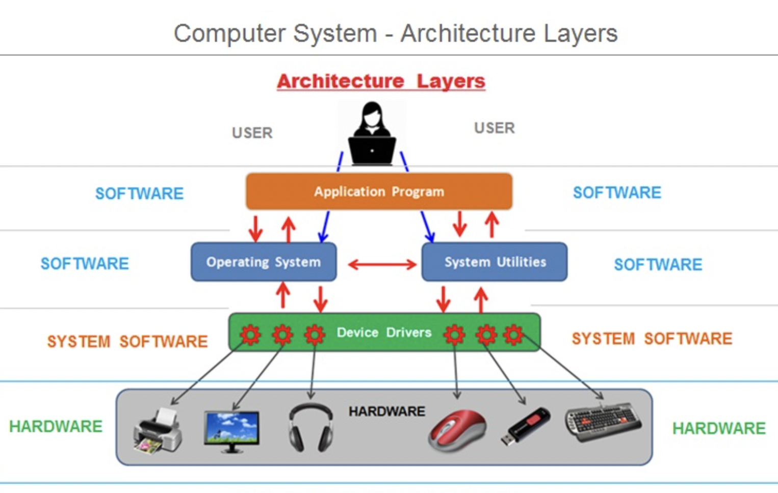

Slide 14
What is a Computer Program ?
A computer program is a set of instructions which directs the computer system.
A computer performs various operations only as per the program instructions .
A computer program can be written in any programming language . The computer programs are generally written in using any high level programming language such as Javascript, C, C++ , Java, Python and other programming languages

Slide 15
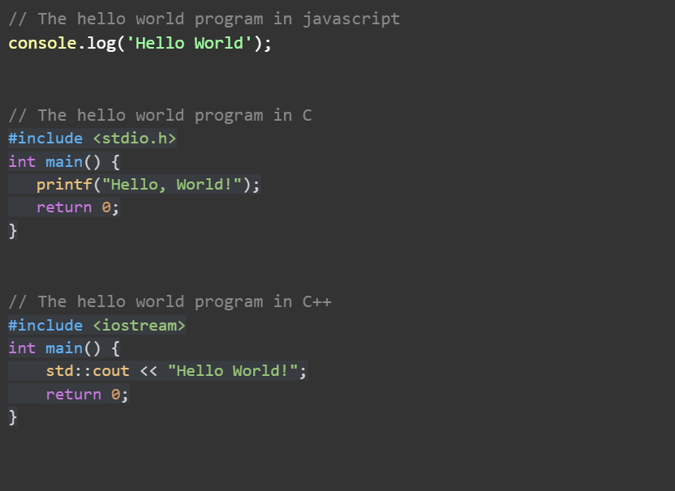
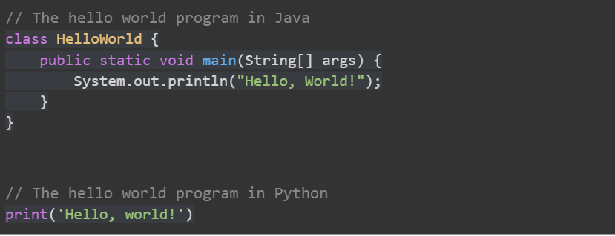

Slide 16
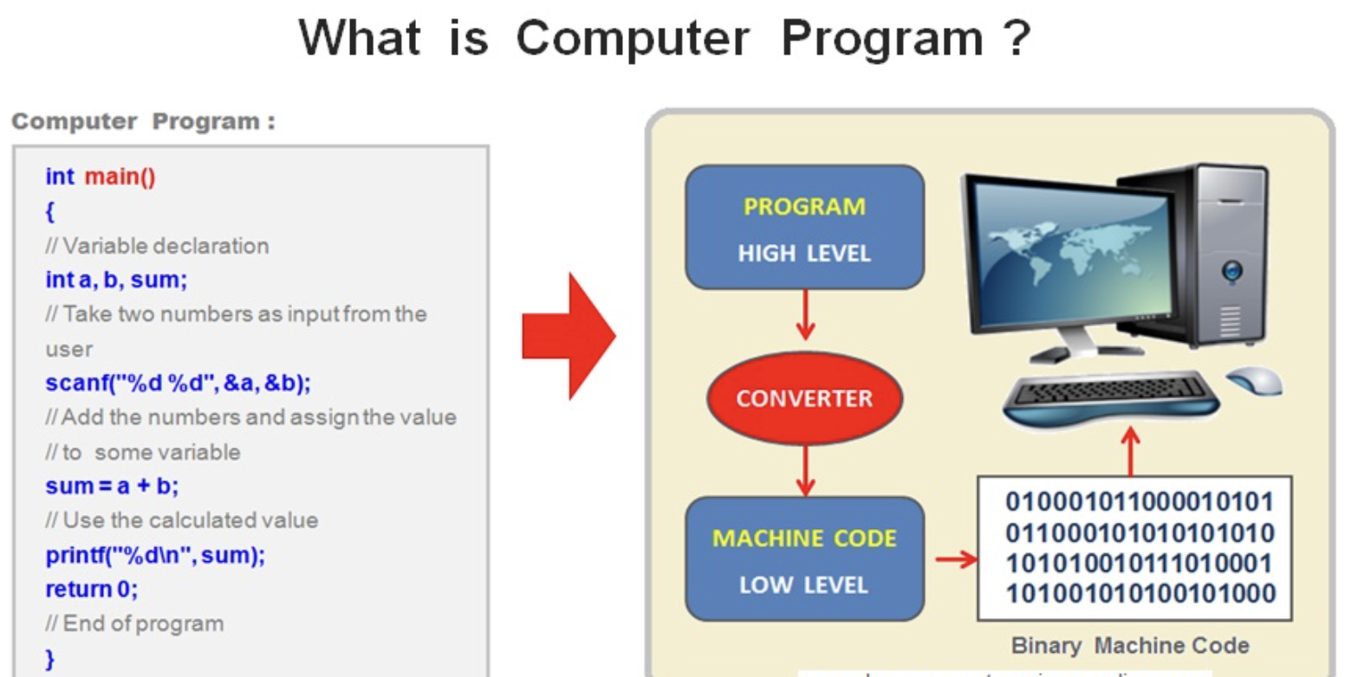
Since a computer understands only machine code instructions in binary , a high level program first needs to be converted into machine code instructions in Binary. This conversion process is referred to as program compilation.

Slide 17
The low level machine code in binary consists of only patterns of 0 ( zero ) and 1 ( one ) .
The computer programs are first written using a human friendly high level programming languages and then compiled to machine code in Binary

Slide 18
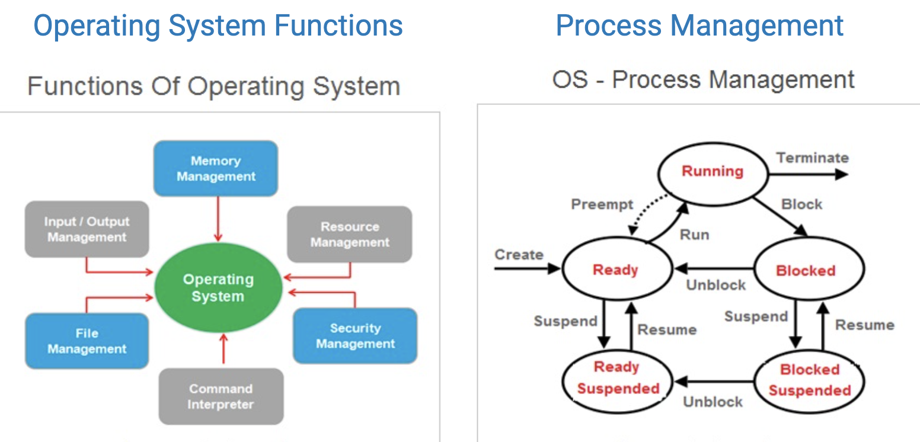
What is an Operating System?
An operating system is an essential component of every computer system.
It is a type of system software that gets loaded first into the memory each time when the computer system is switched on.

Slide 19
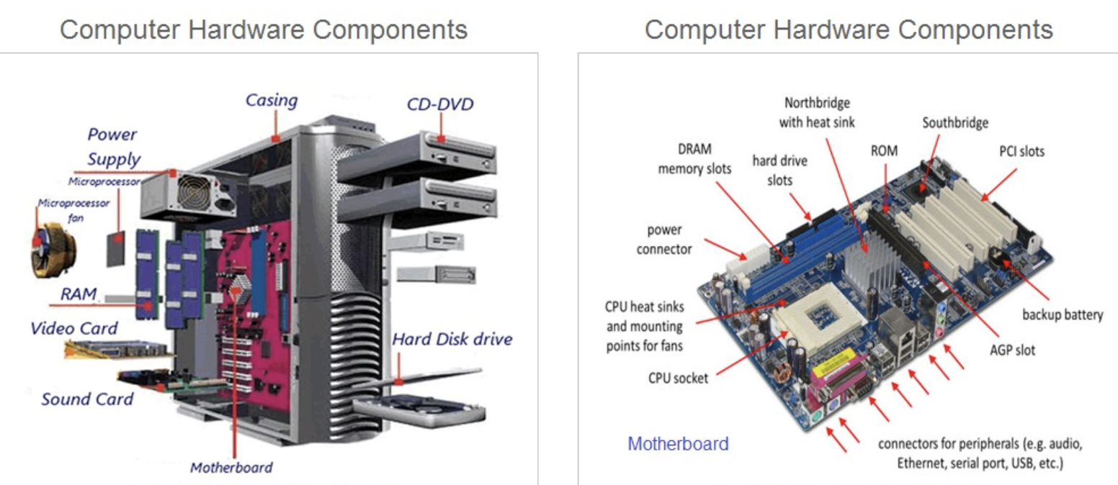
What are Computer Hardware Components ?

Slide 20
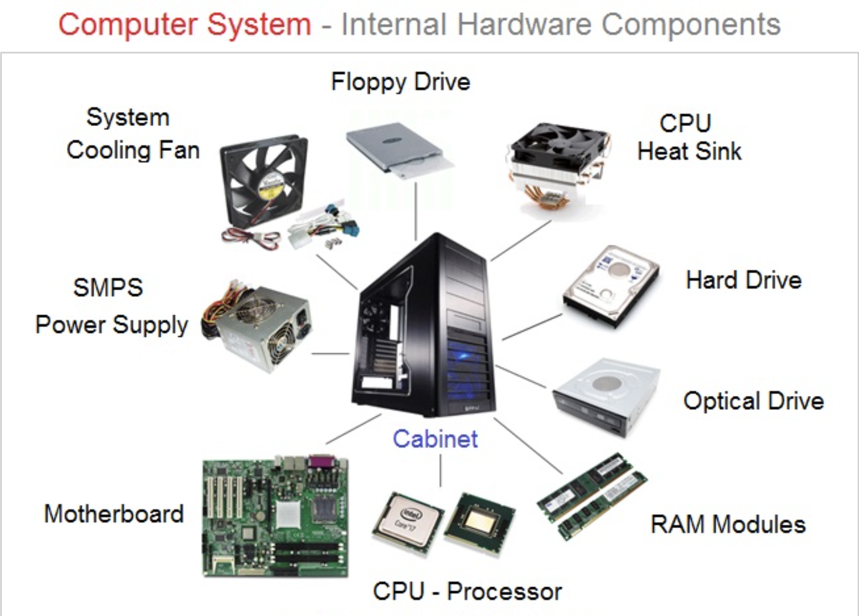

Slide 21
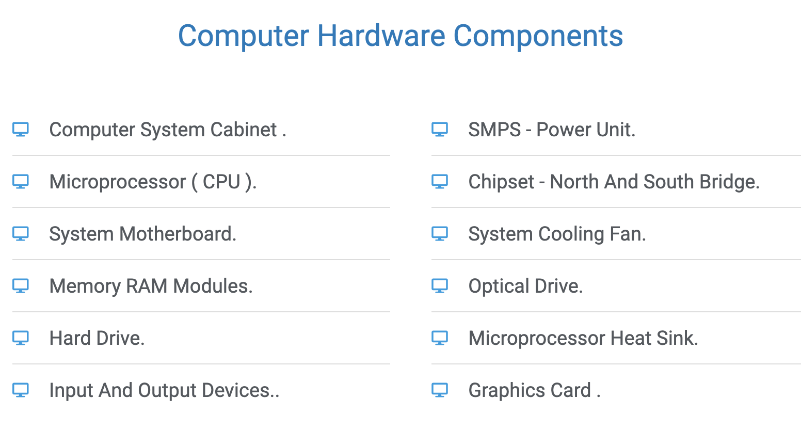

Slide 22
Microprocessor ( CPU )
The central processing unit (CPU) is the brain of the computer .
The CPU is also alternately referred as microprocessor or simply processor.
The CPU is responsible to perform all the arithmetic calculations and logical operations.
RAM - Random Access Memory
The main memory RAM is considered to be the main system memory.
The CPU starts the program execution only when it is loaded into the main memory.
The most commonly used RAM size is 4 GB , 8 GB and 16 GB. RAM is also referred to as primary memory or volatile memory .

Slide 23
Disk Memory ( Hard Disk )
The main memory RAM has limited capacity and therefore , the computer makes use of another storage device called disk memory.
This memory is slower than RAM(Main Memory).
The disk memory is also referred to as secondary memory or permanent ( Non-volatile ) memory.

Slide 24
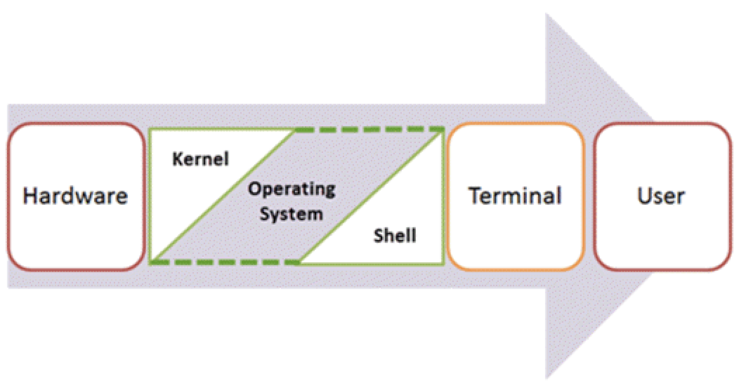
What is the terminal/command-prompt?

Slide 25
https://drive.google.com/file/d/1NLaEMcigMctgmgRAVdCaOqv96_hwvZ7j/view?usp=sharing
https://drive.google.com/file/d/1MCg99ih2ixWzQUVXVHqdpoBWh0Tt7hBR/view?usp=sharing

Slide 26
Some useful commands
Cheat Sheet
Must learn commands
man
ls
cd
pwd
mkdir
rmdir
rm
mv
cp
chmod
cat

Slide 27
How does the Internet work?
https://www.youtube.com/watch?v=LZIxRuGwBIE

Slide 28
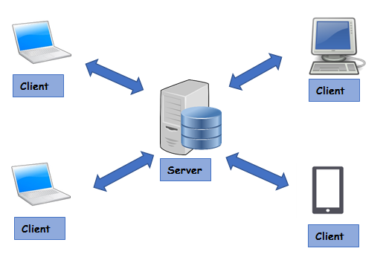
Client server architecture

Slide 29

Assignments (Basic)
https://drive.google.com/file/d/1sxyogRS-GnJYAqQux-2M8yNkzRbiMbAF/view?usp=sharing
https://drive.google.com/file/d/1-KR8XJ6XLgo_2kPDSp1BK_iuzyLj6VN5/view?usp=sharing

Slide 30
Assignments (Medium)
https://www.indiabix.com/computer-science/computer-fundamentals/

Slide 31
Self Learn Assignment
https://edu.gcfglobal.org/en/computerbasics/computer-basics-quiz/1/
https://www.tutorialspoint.com/basics_of_computer_science/basics_of_computer_science_online_quiz.htm

Slide 32

Common Doubts/Question
https://drive.google.com/file/d/1y7L05UoD-Iob0jKqH0mo9KHYW5VJE3N2/view?usp=sharing

Slide 33

Interview Question & Answer
https://drive.google.com/file/d/1jp1lE2wJocmDX-_i8OyAA7551NHGEN5m/view?usp=sharing

Slide 34

Reference/Resources Link
https://drive.google.com/file/d/1mcl53nUxrcRe-dLpVDZILYzCW665oWsl/view?usp=sharing
https://tldr.sh/

Slide 35

Next Class Video/Article
https://code.visualstudio.com/ - Install in your System
https://www.google.com/intl/en_in/chrome/ - Install in your System
https://git-scm.com/ - Install in your System
https://ubuntu.com/tutorials/install-ubuntu-desktop#1-overview - How to install Ubuntu

